Slide 1
Chapter 11:
Binary Search Trees
Data Structures in Java: From Abstract Data Types to the Java Collections Framework
by Simon Gray

Slide 2
Introduction
Binary Search Tree (BST) – a Binary Tree whose elements are stored such that an inorder traversal would produce an ordered list
  elegantly described using a recursive definition (soon!)
  but…BSTs can be unbalanced; bad for searching
Want to make search of a BST efficient
  AVL Tree: idea – minimize the height of the tree
  Splay Tree: idea – optimize for repeated searches
11-<number>

Slide 3
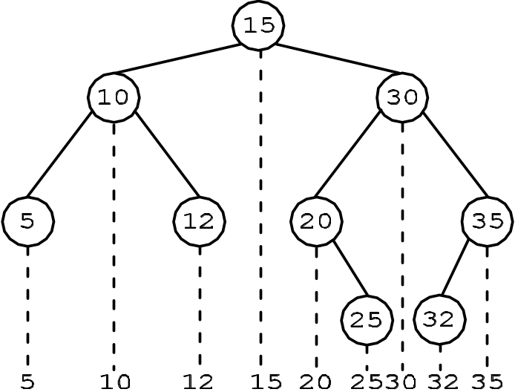
Search Trees
A Binary Search Tree (BST) is a binary tree whose elements are ordered such that:
For any node in the tree, all the elements in the node’s left subtree are less than the node’s element and all the elements in its right subtree are greater than the node’s element. We will refer to this as the binary search tree property. This ordering implies that duplicates are not allowed
The left and right subtrees are binary search trees
Accesses to a Binary Tree are
by position
Accesses to a Binary Search
Tree are by value
11-<number>

Slide 4
Binary Search Tree ADT
Description
This ADT describes a binary search tree (BST) whose element type is left unspecified. The ordering of the tree’s elements is according to their “natural” ordering. Duplicates are not allowed.
Properties
1. A BST is a hierarchical data structure. A node in a BST can have 0 to 2 children.
2. The root is the access point to a BST.
3. Elements are inserted such that all the elements in the node’s left subtree are less than the node’s element and all the elements in the node’s right subtree are greater than the node’s element. This is called the binary search tree property.
4. The elements of a BST must be comparable to one another.
11-<number>

Slide 5
Binary Search Tree ADT
Attributes
size: The number of nodes in this BinarySearchTree.
root: The root of this BinarySearchTree; a null value not part of the tree when the tree is empty.
Operations
BinarySearchTree ( )
pre-condition: none
responsibilities: constructor; create an empty BinarySearchTree
post-condition: size is set to 0
root is set to a null value
returns: nothing
11-<number>

Slide 6
Binary Search Tree ADT
add ( Type element )
pre-condition: element is not null, is not already in the tree and is comparable to the other elements in the tree
responsibilities: add an element to the tree such that the BST properties are maintained
post-condition: size is incremented by 1
element is added to the tree
returns: nothing
exception: if element is null, is already in the tree or is not comparable to other elements in the tree
remove( Type element )
pre-condition: element is not null and is comparable to the other elements in the tree
responsibilities: remove element from the tree such that the BST properties are maintained. If the target is not in the tree, nothing happens and the tree is not changed
post-condition: size is decremented by 1, if element was in the tree element is removed from the tree
returns: nothing
11-<number>

Slide 7
Binary Search Tree ADT
contains( Type target )
pre-condition: target is not null
responsibilities: determine if target is stored in this tree
post-condition: the tree is unchanged
returns: true if target is found in this tree, false otherwise
exception: if target is null
iterator ()
pre-condition: none
responsibilities: create and return an Iterator for this tree. The iterator performs an inorder traversal of this tree’s elements
post-condition: the tree is unchanged
returns: an Iterator for this tree
11-<number>

Slide 8
Tree Iterator
The BST object will supply the client with an iterator object the client uses to iterate over the elements stored in the BST
  this is the way iteration was done over the List implementations and BasicCollection
The Tree Iterator will perform an inorder traversal of the tree, but not recursively, as done in the last chapter since that doesn’t allow the client to control the iteration.
11-<number>

Slide 9
Tree Iterator Methods
Instead, the Tree Iterator will implement the Iterator interface and simulate the recursive calls of an inorder traversal by maintaining its own stack
Pseudocode: TreeIterator()
create the stack
node = this tree’s root
while node is not null // check for base case
push node onto the stack // recursive case—left
node = node’s left child
methods continued
on next slide
11-<number>

Slide 10
Tree Iterator Methods
Pseudocode: hasNext()
true if the stack is not empty false otherwise
Pseudocode: next()
if the stack is empty
throw an exception
node = popped stack item
value is node’s element
node = node’s right child // recursive case—right
while node is not null // check for base case
push node onto the stack
node = node’s left child
// loop post-condition: base case met—found a null left child
return value
11-<number>

Slide 11
Creating a Test Plan
Look at two test cases
add()
  need to verify that the element was added and that the tree remains a BST
remove()
  need to verify that the element was removed and that the tree remains a BST
Also
Use trick from last chapter; dump the elements of the BST to a List and verify the elements are in ascending order
Verify that all preconditions are checked
11-<number>

Slide 12
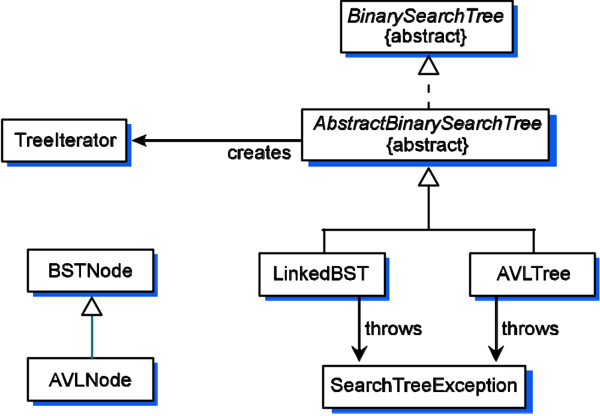
Implementing the Binary Search Tree ADT
Want to implement BST so that it is easily extended to produce an implementation for AVL Tree.
Requires some careful thinking.
Use lessons learned
in earlier chapters:
interfaces and abstract
classes
11-<number>

Slide 13
The BSTNode Class
1 package gray.adts.binarysearchtree;
2 /**
3 * A binary search tree is composed <tt>BSTNode</tt>‘s.
4 * The element stored in must be comparable with other
5 * elements in the BST.
6 */
7 public class BSTNode<E extends Comparable<? super E>> {
8 protected BSTNode<E> parent;
9 protected BSTNode<E> leftChild;
10 protected BSTNode<E> rightChild;
11 protected E element;
Plus two constructors:
one that takes a data element to store in the node
one that takes a data element and references to become the
node’s left and right subtrees
Note: the data fields are protected instead of private. Why?
11-<number>

Slide 14
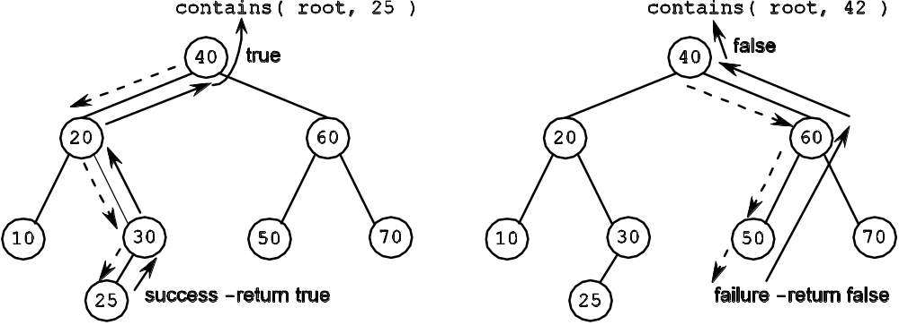
contains() – a recursive method
false, if node is null base case – failure
contains( node,
target ) =
true, if node’s element is equal to the target base case – success
contains( node’s left child, target), if target < node’s element recursive case – left
contains( node’s right child, target), if target > node’s element recursive case – right
where:
node – the root of the subtree to search (initially the root of the tree)
target – the element for which we are searching
Note that the
query is
passed down
the tree and
the result is
passed back
up the tree
Call and return paths for successful and unsuccessful contains() calls
11-<number>

Slide 15
contains() – a recursive method
1 /**
2 * Determine if <tt>target</tt> is in the tree.
3 * @param target the element to look for; can’t be <tt>null</tt>
4 * @return <tt>true</tt> if found, <tt>false</tt> otherwise
5 * @throws SearchTreeException if <tt>target</tt> is <tt>null</tt>
6 */
7 public boolean contains( E target) {
8 if ( target == null )
9 throw new SearchTreeException();
10 return contains( this.root(), target );
11 }
12
13 protected boolean contains( BSTNode<E> node, E target ){
14 if ( node == null ) // base case — failure
15 return false;
16
17 int compareResult = target.compareTo( node.element );
18 if ( compareResult < 0 ) // recursive case — left
19 return contains( node.leftChild, target );
20 else if ( compareResult > 0 ) // recursive case — right
21 return contains( node.rightChild, target );
22 else
23 return true; // base case — success
24 }
This is the public
version clients see
Does the subtree rooted at node contains target?
This is the private
version that does the work
Note direct access
to node’s data
fields
11-<number>

Slide 16
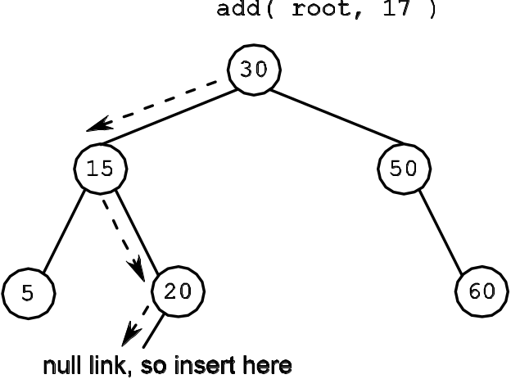
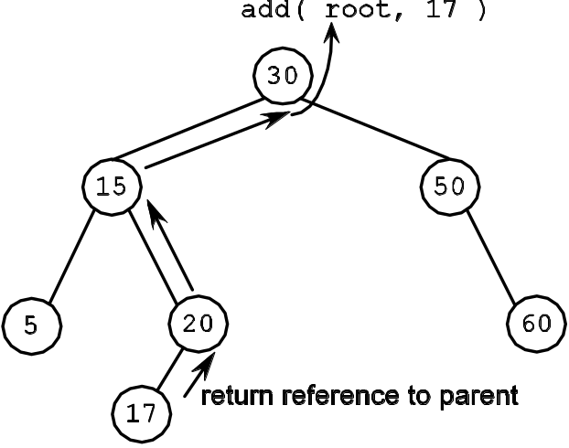
add() – a recursive method
BSTNode( element ), if node is null // base case – success – do insertion
add (node,
element ) =
exception, if element == node.element // base case – failure – no duplicates
node.leftChild = add( node.leftChild,
element ) if element < node.element //recursive case – left
node.rightChild = add( node.rightChild,
element ) if element > node.element // recursive case – right
where:
node – the root of the subtree to add (initially it is the root of the tree)
element – the element to be added to the tree
Important!
Note that a node reference is passed back up the tree all
the way to the root
(a) The path followed to find 17’s insertion point.
(b) The new node is always inserted at a leaf position
11-<number>

Slide 17
add() – a recursive method
10 public void add( E element ) {
11 if ( element == null )
12 throw new SearchTreeException();
13 setRoot( add( null, this.root(), element ) );
14 size++;
15 }
16
17 protected BSTNode<E> add( BSTNode<E> parent, BSTNode<E> node, E element ){
18 if ( node == null ) { // base case
19 node = new BSTNode<E>( element );
20 node.parent = parent;
21 }
22 else { // recursive cases
23 int compareResult = element.compareTo( node.element );
24 if ( compareResult < 0 ) // recursive case — left
25 node.leftChild = add( node, node.leftChild, element );
26 else if ( compareResult > 0 ) // recursive case — right
27 node.rightChild = add( node, node.rightChild, element );
28 else
29 throw new SearchTreeException( "Duplicate element: " +
30 element.toString() );
31 }
32 return node;
33 }
Note that we set the root to be a reference to the node returned by the original call to add()
Parent-child link will be re-established as the recursion unwinds
return a reference to this node to the caller (which will be this node’s parent)
11-<number>

Slide 18
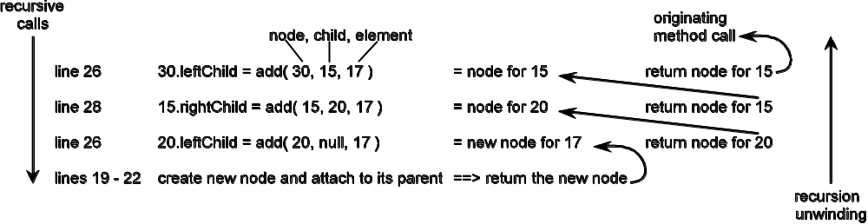
add() – a recursive method
Establishing the parent-child link as the recursion unwinds
11-<number>

Slide 19
remove() – a recursive method
Removing a node is a little trickier
  Need to keep the tree connected, and
  Need to maintain the BST property
There are three cases to consider
  Case 1 The node to remove is a leaf
  Case 2 The node to remove is an internal node with one child
  Case 3 The node to remove is an internal node with two children
11-<number>

Slide 20
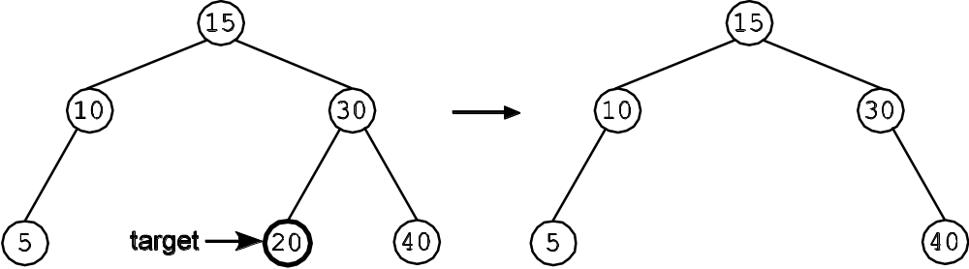
remove(): Case 1 removing a leaf
Removing a leaf node just requires updating its parent’s child link to be null
11-<number>

Slide 21
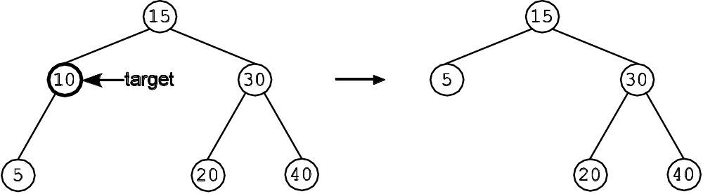
remove(): Case 2 target has 1 Child
Removing a node with one child from a binary search tree – move the single child into the parent’s position
11-<number>

Slide 22
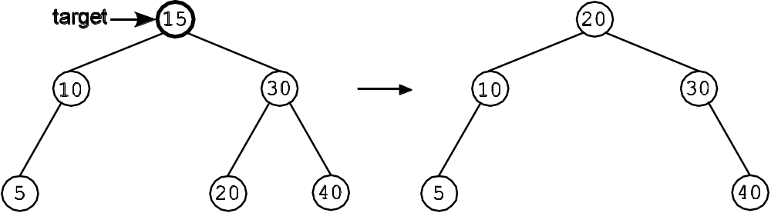
remove(): Case 3 target has 2 Children
15’s successor
in the tree is 20
Removing a node with two children from a binary search tree – replace the value in the target node with the value in its successor in the tree, then delete that successor
Slight complication: the “successor” in the tree
might have a right child. This is just Case 2!
11-<number>

Slide 23
AbstractBinarySearchTree
The recursive methods all take two arguments: a node and a target element. This is necessary because what happens in the recursive case always depends on the combination of the value at the current position (node) in the tree and the target element
The BinarySearchTree interface specifies that the public add() , remove(), and contains() methods only supply a target as an argument
This is easily handled by having the public method call an internal utility method using the tree’s root as the starting point
11-<number>

Slide 24
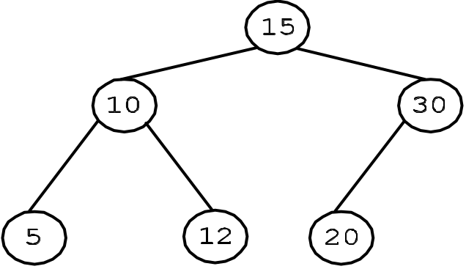
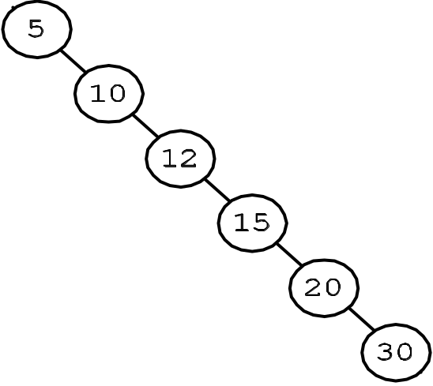
The Need for a Balanced Search Tree
A Binary Search Tree can become badly unbalanced, turning the search time from O(log₂n) in the best case to O(n) in the worst case
Bad tree!
Good tree!
Same number of elements in each tree, but very
different search times (in the worst case)
11-<number>

Slide 25

The Need for a Balanced Search Tree
A perfectly balanced tree is the ideal. A complete binary tree with n nodes has a height of
An add() or remove() done on a complete binary tree may change the tree’s structure and a great deal of work would have to be done to restore it as a complete binary tree
When the costs outweigh the benefits, we must consider alternatives
11-<number>

Slide 26
AVL Trees
An AVL tree is a BST with the following additional constraints:
The height of a node’s left and right subtrees differ by no more than 1
The left and right subtrees are AVL trees
This approach is
cost effective, and
guarantees that the height of the tree is a small multiple of log₂n, so it still provides O(log₂n) access time
11-<number>

Slide 27
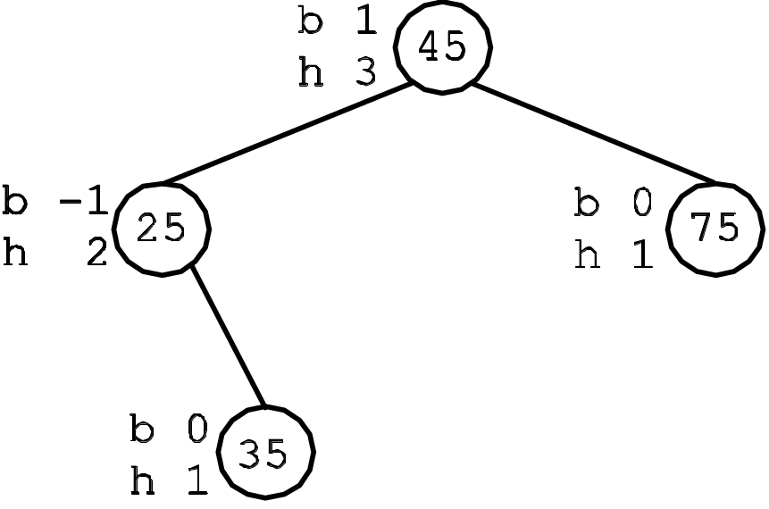
AVL Trees: Height and Balance
Calculating heights and balances is done from the leaves up
● An empty subtree has a height of 0
● A leaf always has a balance of 0 and a height of 1
● An internal node’s height is the height of its taller subtrees plus 1:
node.height = (height of taller of two subtrees) + 1
● An internal node’s balance is the height of its left subtree minus the height of its right subtree:
node.balance = height left subtree – height right subtree
A balance of 1 means
the left subtree is deeper
A balance of -1 means the right subtree is deeper
A balance of 0 means the subtrees have the same height
A balance of 2 or -2 means the tree is no longer AVL-balanced
11-<number>

Slide 28
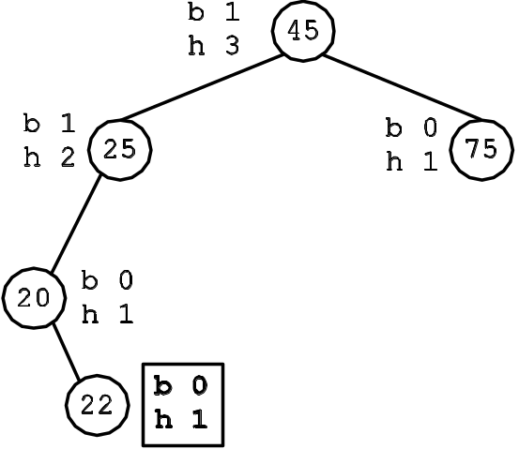
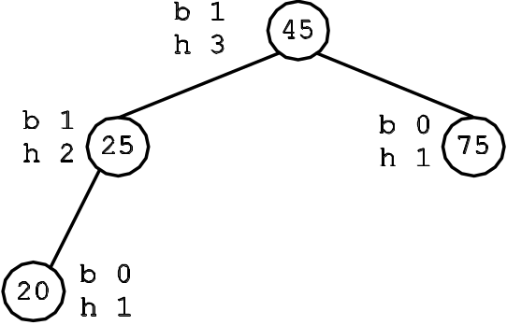
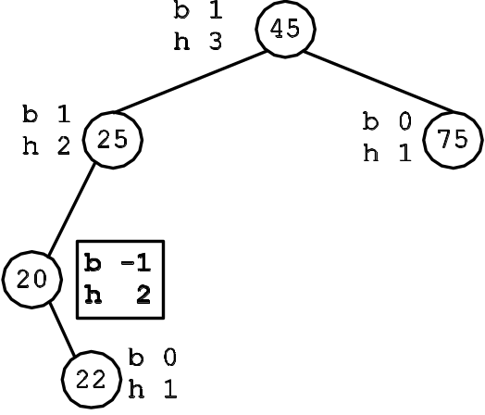
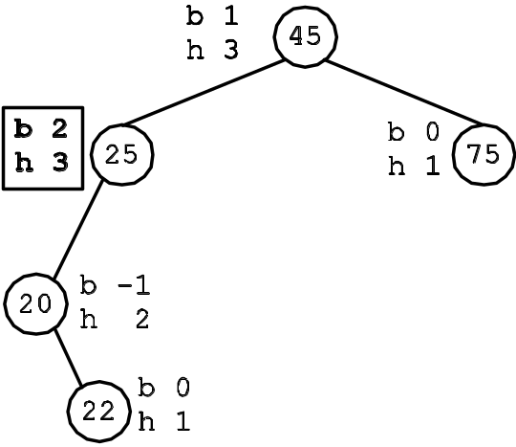
Detecting Imbalance
(a) The AVL tree before add(22)
(b) The AVL tree after add(22). Now begin recomputing heights and balances
☹
(c) The recomputation occurs moving up the tree
(d) An imbalance is found at 25, where balance becomes 2
11-<number>

Slide 29
Restoring AVL Balance: Rotations
When an imbalance is discovered, balance is restored through rotations of subtrees
There are four cases
  Case LL The balance at X’s left child, X_{L}, is 1, so the Left child’s Left subtree, rooted at X_{LL}, is taller
  Case LR The balance at X’s left child, X_{L}, is –1, so the Left child’s Right subtree, rooted at X_{LR}, is taller
  Case RR The balance at X’s right child, X_{R}, is –1, so the Right child’s Right subtree, rooted at X_{RR}, is taller
  Case RL The balance at X’s right child, X_{R}, is 1, so the Right child’s Left subtree, rooted at X_{RL}, is taller
11-<number>

Slide 30
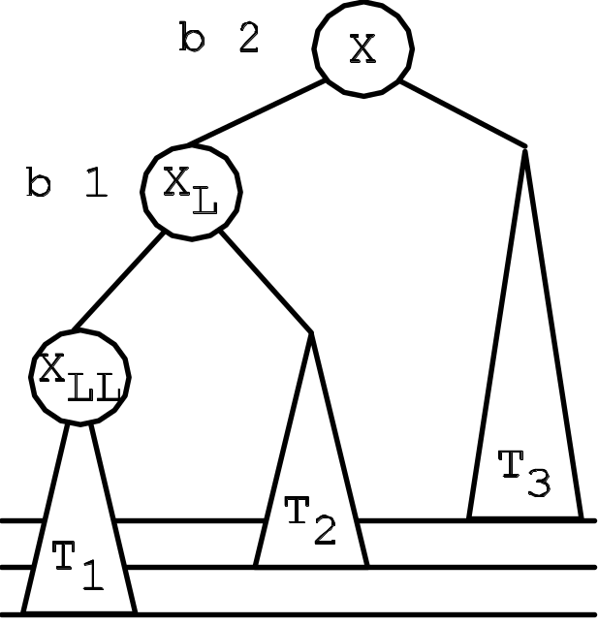
Case LL
The balance at X’s left child, X_{L}, is 1, so X’s Left child’s Left subtree rooted at X_{LL} is taller
11-<number>

Slide 31
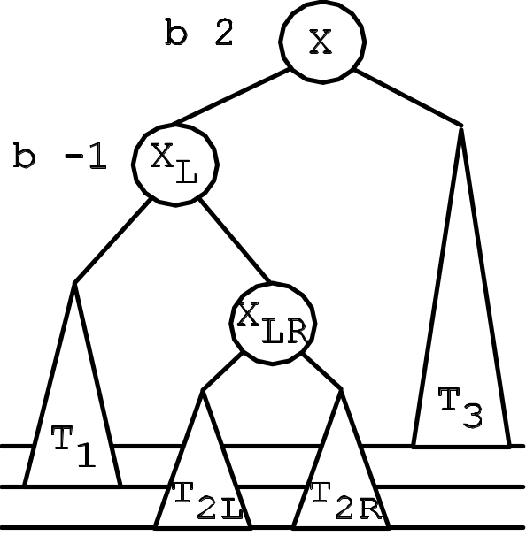
Case LR
The balance at X’s left child, X_{L}, is –1, so X’s Left child’s Right subtree rooted at X_{LR} is taller
11-<number>

Slide 32
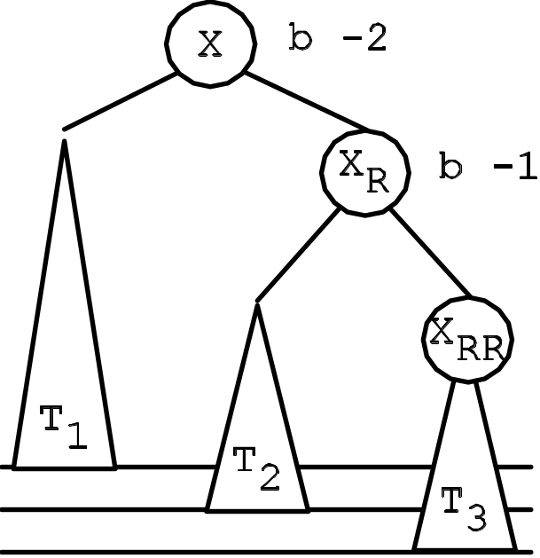
Case RR
The balance at X’s right child, X_{R}, is –1, so the Right child’s Right subtree rooted at X_{RR} is taller
This is the mirror
image of Case LL
11-<number>

Slide 33
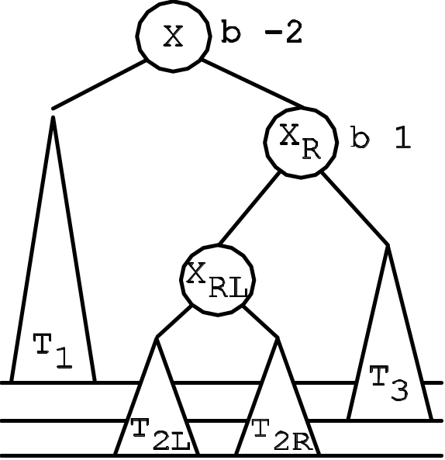
Case RL
The balance at X’s right child, X_{R}, is 1, so the Right child’s Left subtree rooted at X_{RL} is taller
This is the mirror
image of Case LR
11-<number>

Slide 34
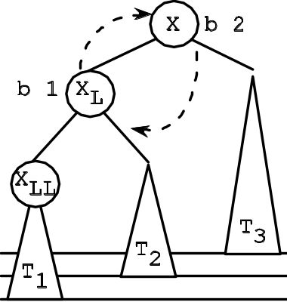
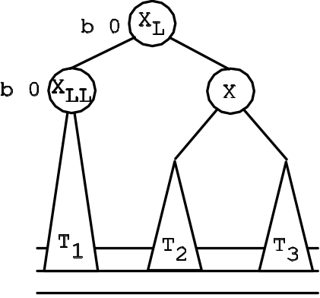
Case LL Rotation
Solution: make a single right (clockwise) rotation around X by moving the tree rooted at X_{L} up a level such that
  X becomes X_{L}’s right child
  X_{L}’s right child (T₂) becomes X’s left child
  X_{L} is the new root of the subtree
(a) An LL imbalance at X
(b) Balance is restored by a right (clockwise) rotation
Balance is restored and the BST property is retained: T₂ and X_{L} are moved relative to X, and what we know about the values in T2 is this: X_{L} < values in T₂ < X
Thus T₂ must be between X_{L} (on the left) and X (on the right) in a BST. This is true in the rebalanced tree, so the rebalanced tree is still a BST.
11-<number>

Slide 35
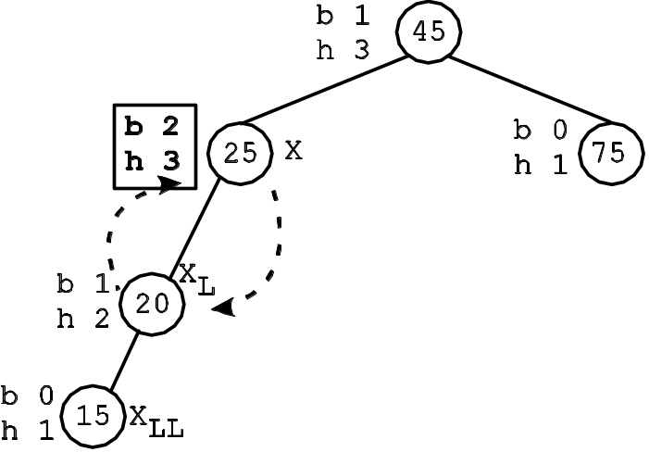
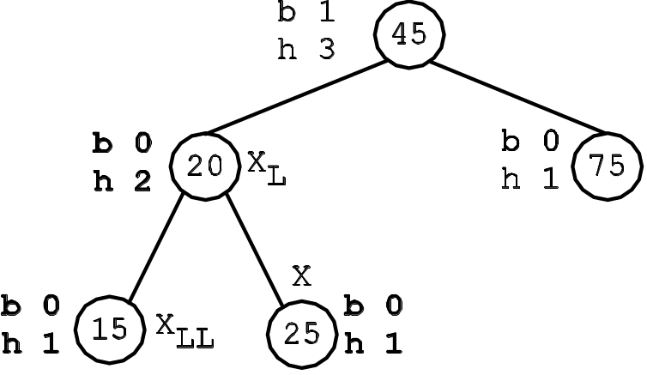
Case LL Rotation Example
(a) An AVL tree with an LL imbalance at X
(b) The AVL tree after a right rotation around X
11-<number>

Slide 36
Case LR Double Rotation
Solution: We need a double rotation
  a left (counterclockwise) rotation of X_{LR} is done around X_{L}. This moves X_{L}’s right child, X_{LR}, up the tree
  X_{LR}’s left subtree (T_{2L}) becomes the right subtree of X_{L}
  X_{LR}’s right subtree (T_{2R}) moves up the tree with X_{LR}
  The result of this left rotation does not restore the balance at X
  we now do a right (clockwise) rotation around X.
  as we saw in the LL case, this moves X’s left child up the tree a level while moving X down a level
11-<number>

Slide 37
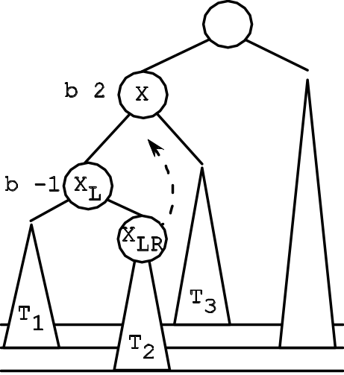
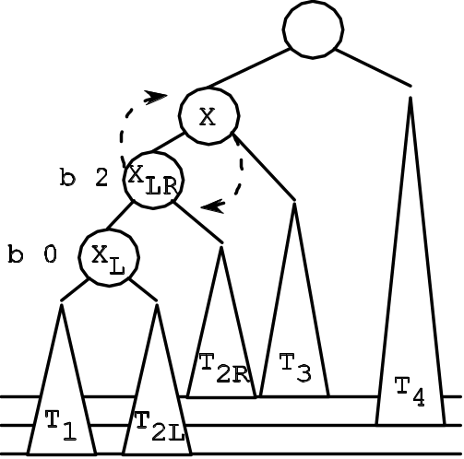
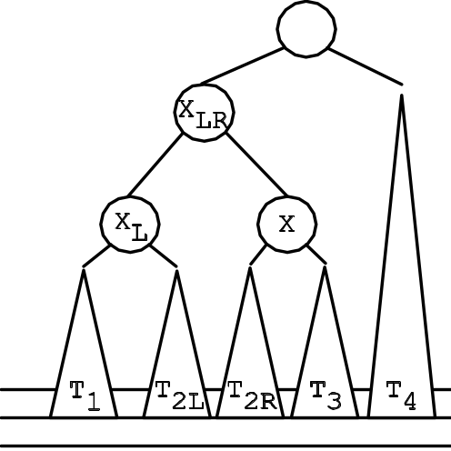
Case LR Double Rotation
(a) Original unbalanced tree. The dotted arc indicates that a left (counterclockwise) rotation of X_{LR} around X_{L} will be done to produce the tree in (b)
(b) The tree is still unbalanced at X. The dotted arc shows the right (clockwise) rotation of X_{LR} around X to produce the balanced tree in (c)
(c) The tree is AVL-balanced
and
second rotation
first rotation
X_{L} < values in T_{2L} < X_{LR} < values in T_{2R} < X
11-<number>

Slide 38
AVL Tree add()
Done pretty much as for LinkedBST
Recursively descend the tree looking for the leaf position where the new value will be inserted
Difference:
  as the recursion unwinds, heights and balances need to be recomputed
  if an imbalance is discovered, its type (LL, RR, LR, RL) needs to be identified and then balance must be restored
11-<number>

Slide 39
AVL Tree remove()
Similar to remove() for LinkedBST, but trickier
As with LinkedBST, replace the target with its successor
Complication
  Need to recompute heights and balances as the recursion unwinds
  BUT the recursive calls will not have descended all the way to the successor node
  How to handle recomputation of heights and balances from the successor node up?
11-<number>

Slide 40
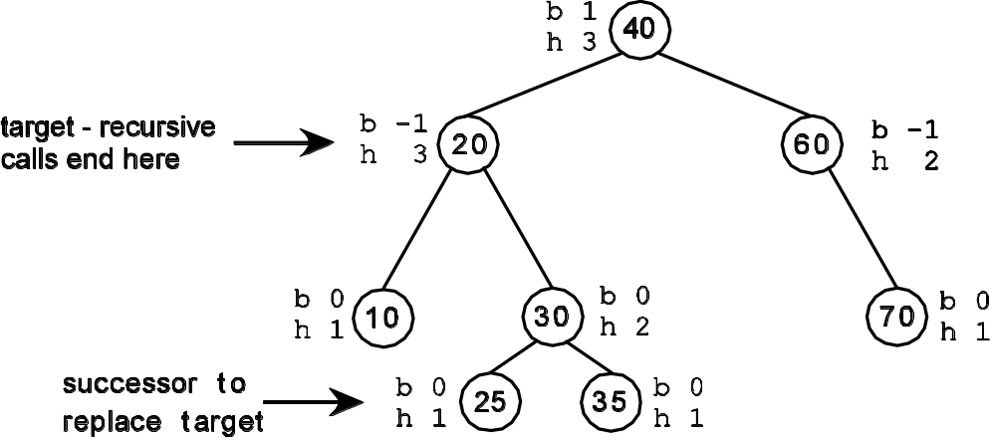
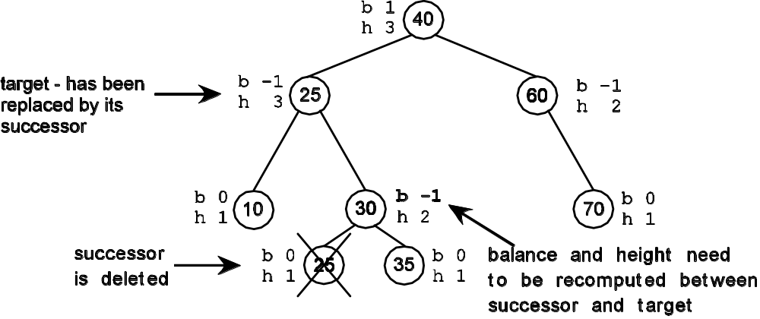
AVL Tree remove()
(a) The recursive calls to remove() will reach the target node (20). The target’s successor (25) is below the target in the tree
(b) A separate mechanism is needed to adjust the tree between the successor (following its removal) and the target
11-<number>

Slide 41
Splay Trees - Motivation
What do AVL-balanced trees get us? They an upper bound on the worst case search time no matter which element is searched for
But what if accesses to the tree were not evenly distributed over its elements? What if there was a pattern of accesses to the tree’s elements?
It would be nice to take advantage of this information to minimize search time
Alas, AVL Trees cannot help us
11-<number>

Slide 42
Splay Trees – the Idea
Idea: always move the most recently accessed element to the root under the assumption that it will be accessed again in the near future. If this turns out to be the case, subsequent accesses will be very efficient
Price: splay trees make no promises about height or balance
  Tradeoff - forego AVL Tree’s guarantee of uniform access time and tolerate an occasional costly, O(n), access time in return for a larger number of very efficient, O(1), accesses, so that over time the average access cost is comparable to that of height balanced trees, O(log₂n)
11-<number>

Slide 43
Splay Trees – a Self-adjusting BST
Splay trees are self-adjusting binary search trees adapted to changing access patterns
SplayTree implements the BinarySearchTree interface with three changes:
add( element ) The node containing element becomes the root of the tree.
contains( target ) Success: The node containing target becomes the root of the tree.
Failure: The last node whose element was compared to the target becomes the root of the tree.
remove( target ) Success: The parent of target becomes the root of the tree. If target was at the root, the left child becomes the root; the right child becomes the root if the left child does not exist.
Failure: The last node whose element was compared to the target becomes the root of the tree
11-<number>

Slide 44
Splay Tree Test Plan
Since a Splay Tree is a BST, all of the BST tests apply
Additional tests address the unique characteristics of splay trees.
  After an add() and successful contains(), verify that the accessed node is the root
  After a remove(), verify that the target’s parent is moved to the root. If the target was already in the root position, verify that the correct child was promoted
  After an unsuccessful contains() or remove(), verify that the last node touched has become the root
11-<number>

Slide 45
Splay Rotations
Unlike with the AVL Tree, the purpose of Splay rotations isn’t to restore balance while maintaining the BST properties. Instead, it is to move some element to the root of the tree while maintaining the BST properties
Note: the AVL Tree rotations always moved some subtree up the tree – we take advantage of that
11-<number>

Slide 46
Splay Rotations
There are two 1-level splay cases and four 2-level splay cases
The goal of the 1-level rotation is to move the target up one level into the root
The goal of a 2-level rotation is to move the target up the tree two levels
Idea: Combine a sequence of 1- and 2-level splay rotations until the target is at the root
11-<number>

Slide 47
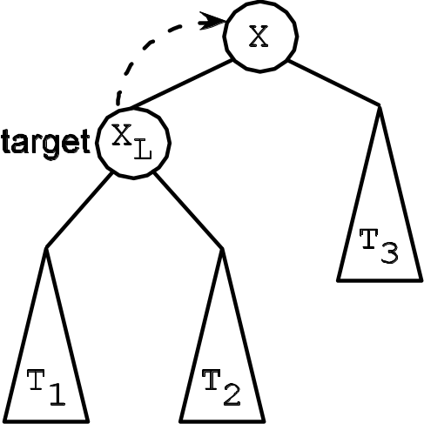
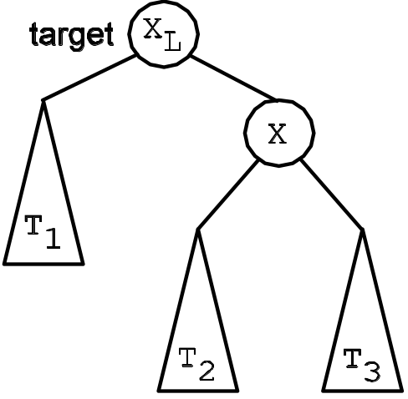
The L-splay Rotation for Splay Trees
(a) The target is the root’s left child
(b) The target is moved to the root position
A 1-level rotation, moving the target up the tree 1 level
11-<number>

Slide 48
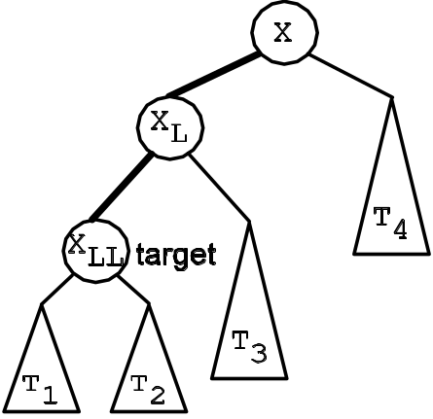
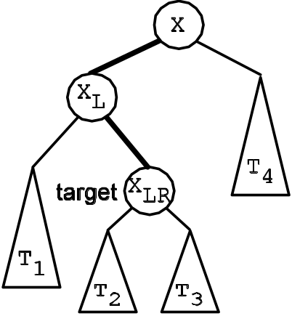
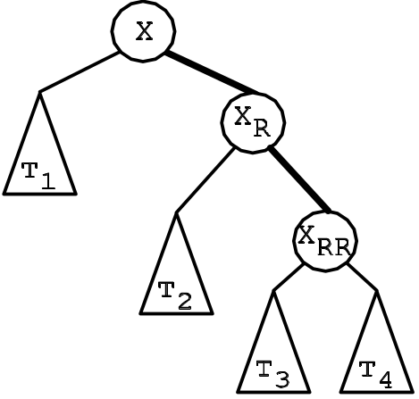
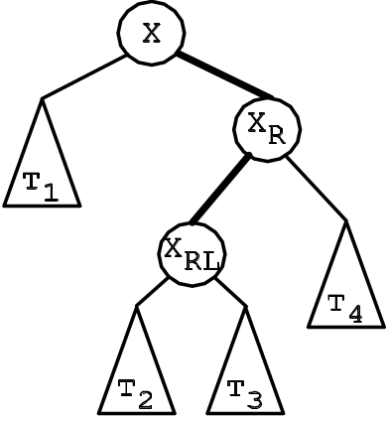
Four 2-level Splay Cases
(a) Splay Case LL – target is the left child of a left child
(b) Splay Case LR – target is the right child of a left child
(c) Splay Case RR – target is the right child of a right child
(d) Splay Case RL – target is the left child of a right child
11-<number>

Slide 49
The 2-level Splay Rotations
Rotations for the LR and RL splay cases are identical to the LR and RL AVL cases
The rotations for LL and RR are a little different from their AVL counterparts
  Instead of doing a single rotation in the AVL case, for splay trees we do two rotations, thus achieving a 2-level shift in the target node (the LL case is in the next slide)
11-<number>

Slide 50
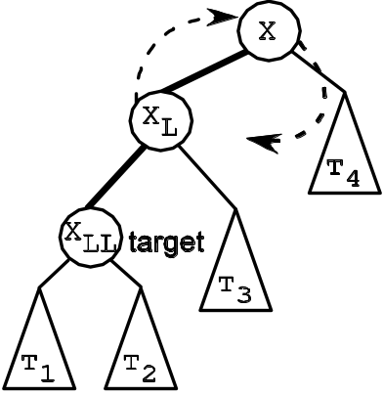
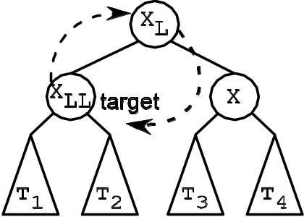
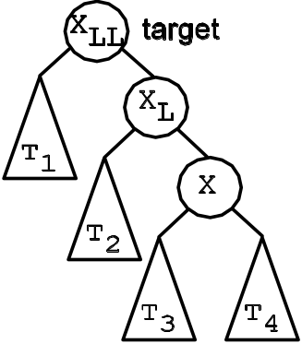
The LL Splay Rotation
Step 1: Do a right (clockwise) rotation of X_{L} around X
Step 2: Do a right rotation of X_{LL} around X_{L}
LL splay complete; target is moved up two levels
11-<number>

Slide 51
Amortization Analysis
The runtime complexity of an individual access to a splay tree is O(n)
But, it can be shown that a sequence of m accesses will have a cost of O(mlog₂n), giving an amortized cost of O(log₂n) per access
Idea: Some operations may be quite costly, but are laying the groundwork that will make operations in the near future very efficient
11-<number>

